Slide 1
Bobcat Wildfire Project
Update August 1, 2025

Slide 2
Burn Severity Classification K-means

Slide 3
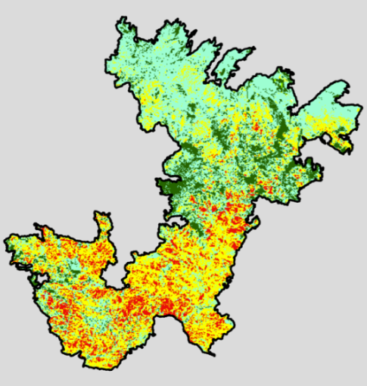
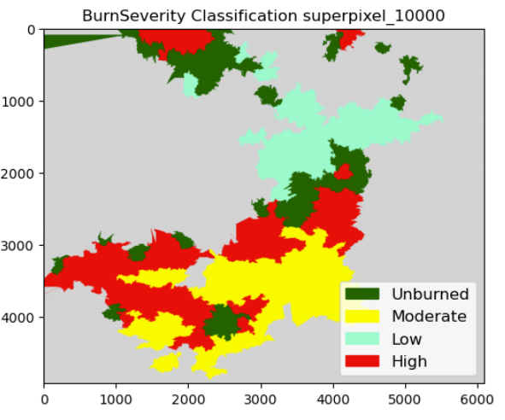
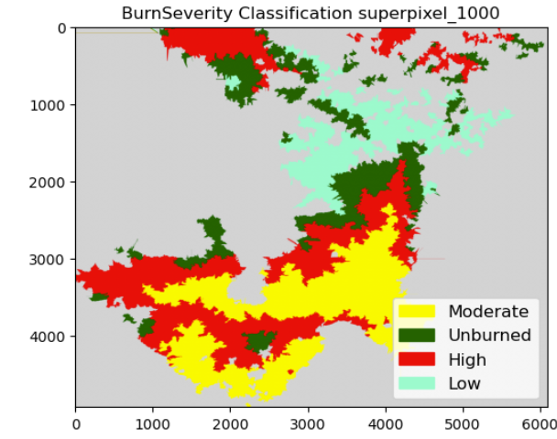
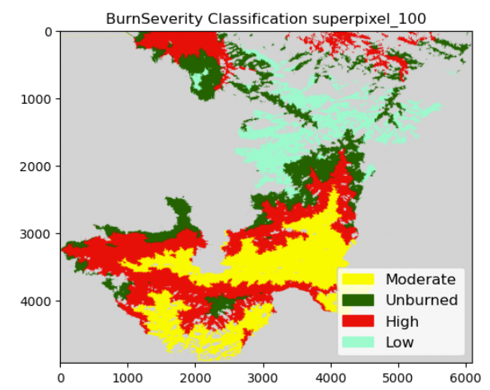
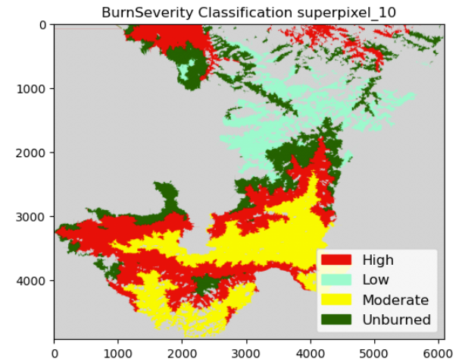
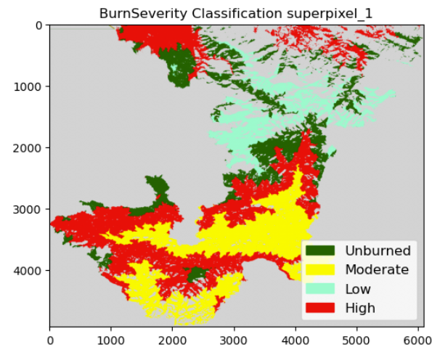
67%
70%
69%
69%
69%

Slide 4
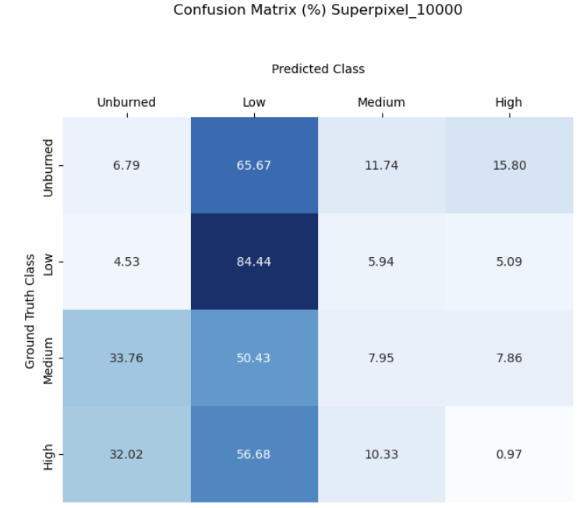
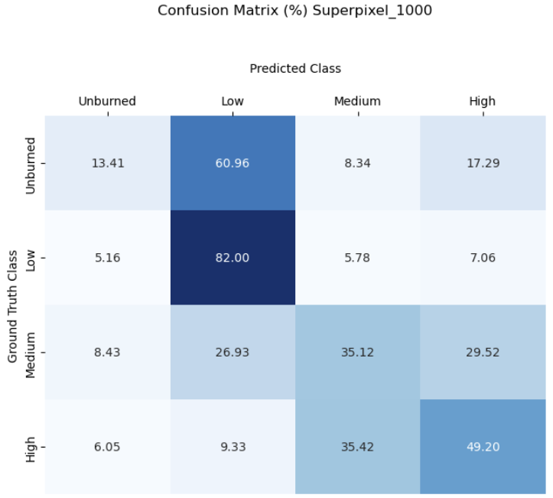
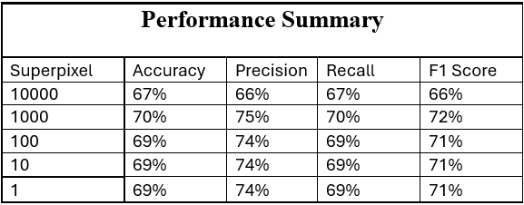
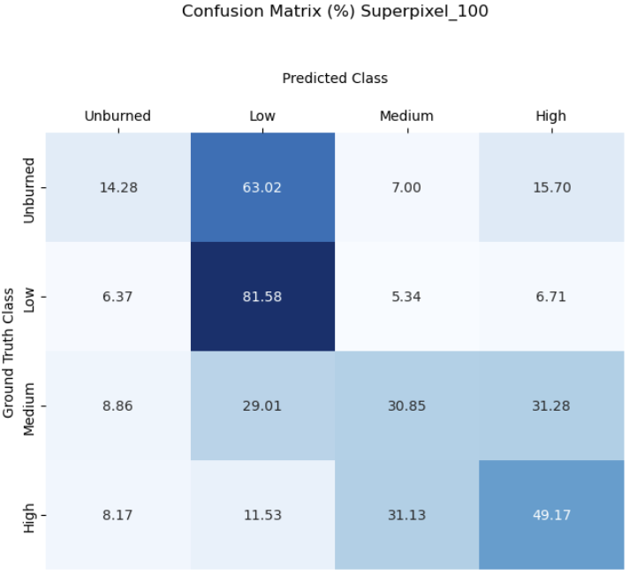
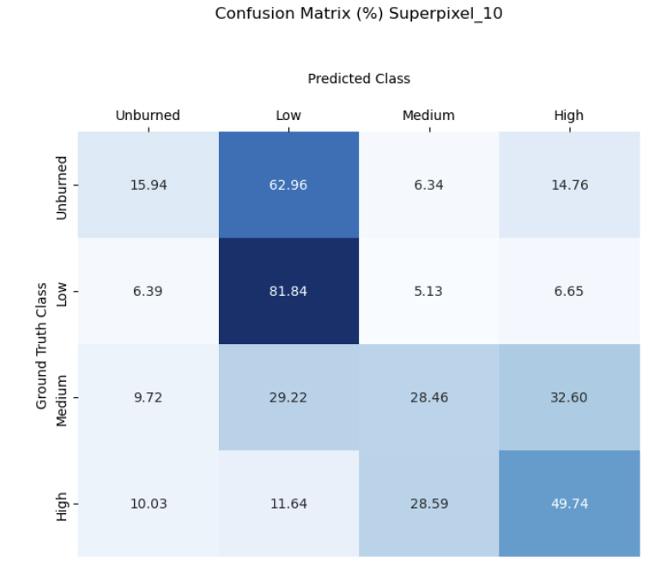
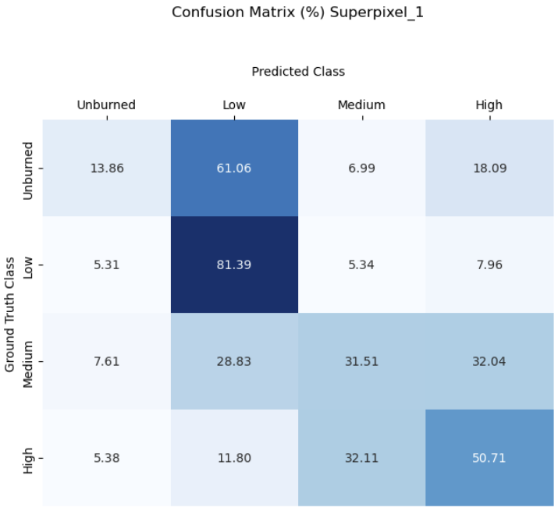
Confusion Matrices

Slide 5
Next Steps: Bobcat Project
We will check if burn severity output improves by using only alpha values and removing hv values.
We will use HV mask to apply to alpha 1 . To handle missing data, we may either focus only on the southern flight line or try filling in the missing values.

Slide 6
Bobcat Wildfire Project
Update July 18, 2025

Slide 7
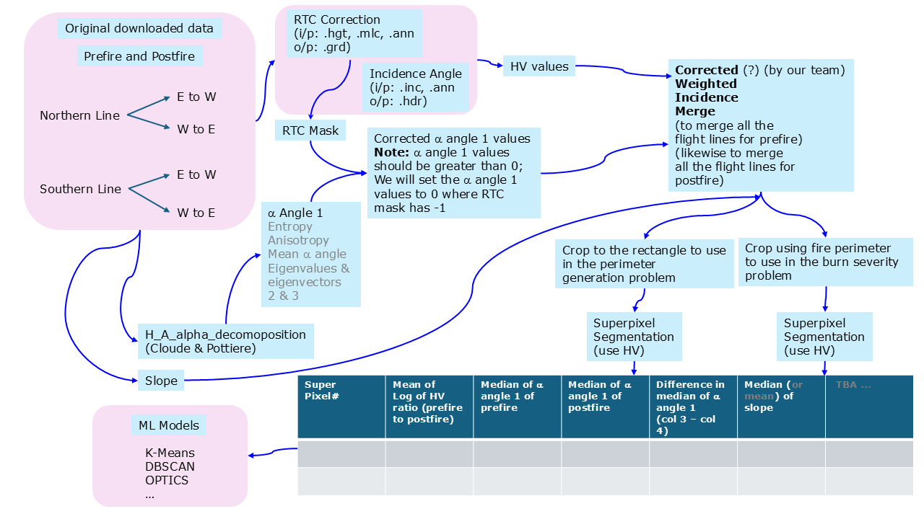
Overview - Recap

Slide 8
Burn Severity Classification Experiment 1
results follow for different sizes of superpixels
K-means
DATASET 1
Mean of Log of HV ratio
Difference in Median of Alpha Angle 1
Median of Slope
DBSCAN
OPTICS
Debugging
Agglomerative Clustering
no better than K-means

Slide 9
Burn Severity Classification K-means
Ground Truth

Slide 10
Burn Severity Classification Experiment 2
results follow for different sizes of superpixels
K-means
DATASET 2
Mean of Log of HV ratio, Median of Alpha Angle 1 of prefire, Median of Alpha Angle 1 of postfire, Median of Slope.
DBSCAN
OPTICS
Debugging
Agglomerative Clustering
no better than K-means

Slide 11
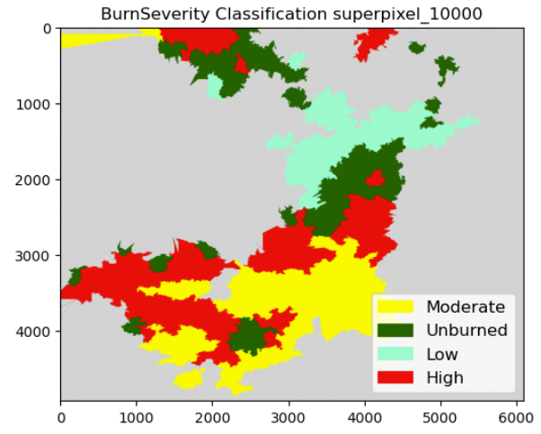
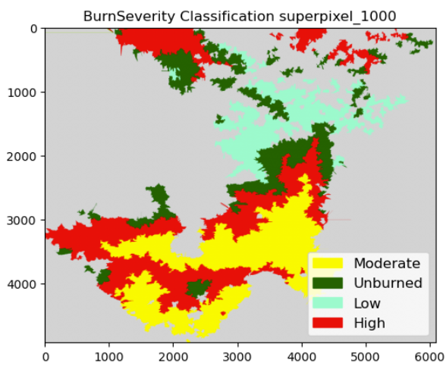
Burn Severity Classification K-means
Ground Truth

Slide 12

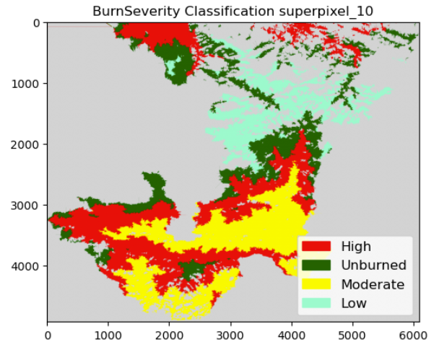
Burn Severity Classification K-means
Ground Truth

Slide 13
Burn Severity Classification Experiment 3
results follow for different sizes of superpixels
K-means
DATASET 3
Mean of Log of HV ratio
Difference in Median of Alpha Angle 1
Mean of Slope
DBSCAN
OPTICS
Debugging
Agglomerative Clustering
no better than K-means

Slide 14
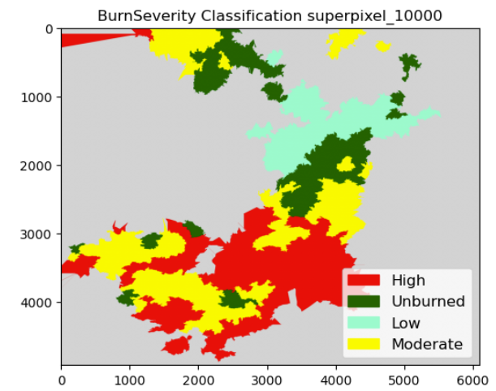
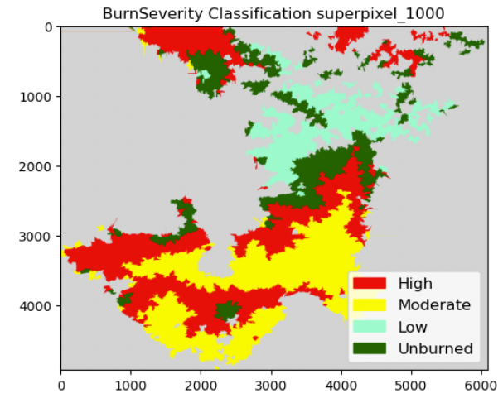
Burn Severity Classification K-means
Ground Truth

Slide 15
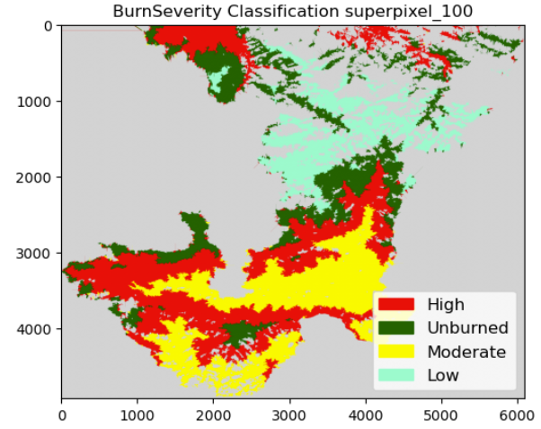

Burn Severity Classification K-means
Ground Truth

Slide 16
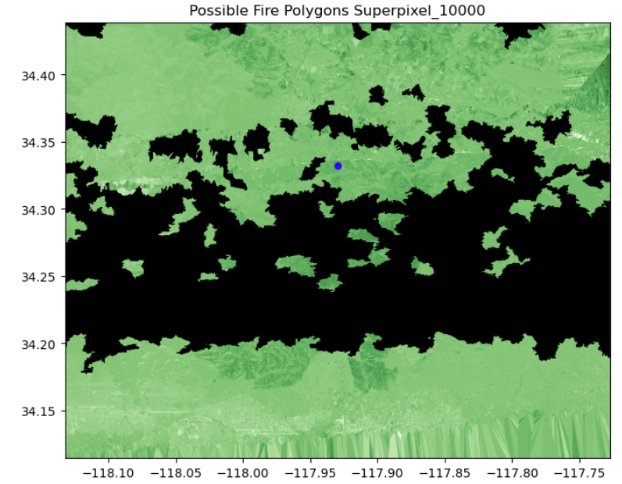
Perimeter Generation Experiment 1
K-means
DATASET 1
Mean of Log of HV ratio, Difference in Median of Alpha Angle , Median of Slope, Standard deviation

Slide 17
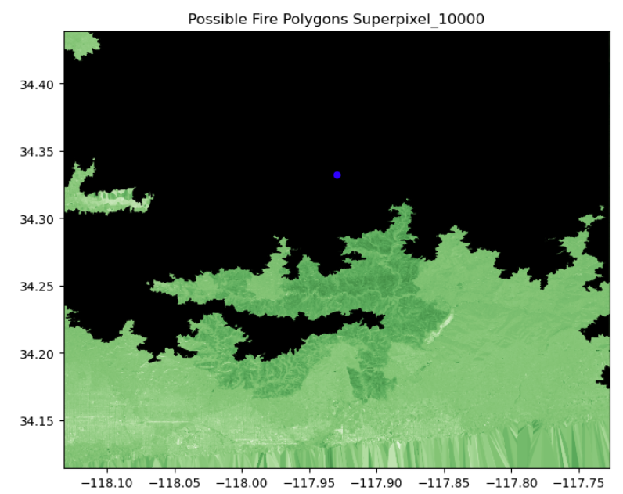
Perimeter Generation Experiment 2
K-means
DATASET 2
Mean of Log of HV ratio, Median of Slope, Standard deviation

Slide 18
Perimeter Generation Experiment 3
results follow for different sizes of superpixels
DATASET 3
Mean of Log of HV ratio, Standard deviation features
K-means

Slide 19
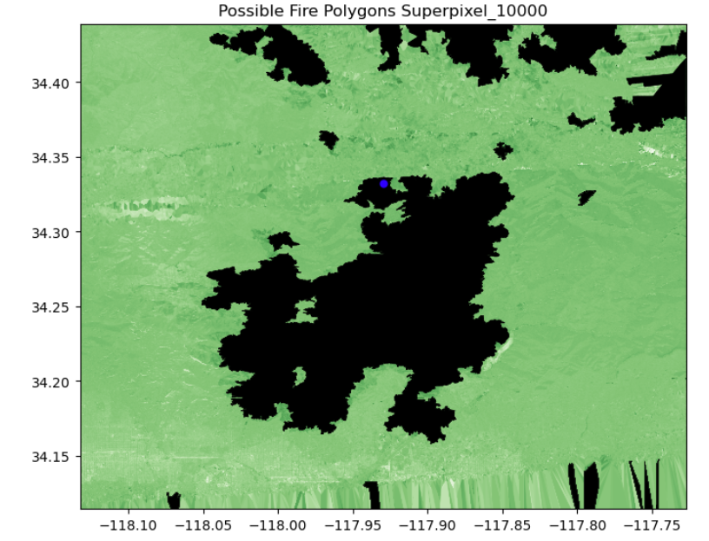
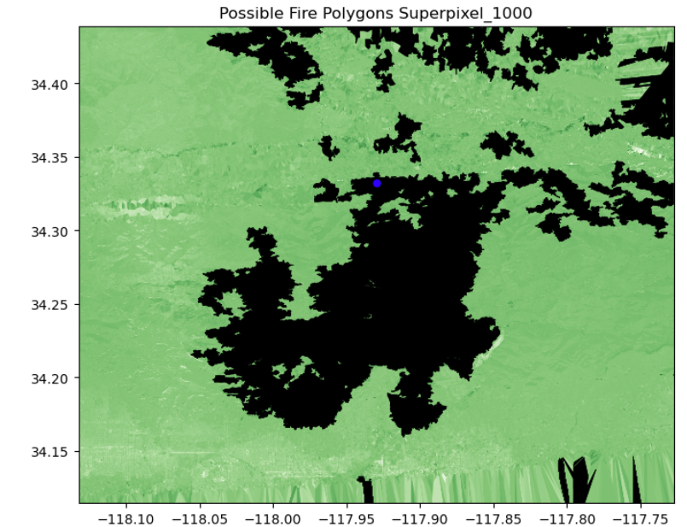
Perimeter generation K-means

Slide 20
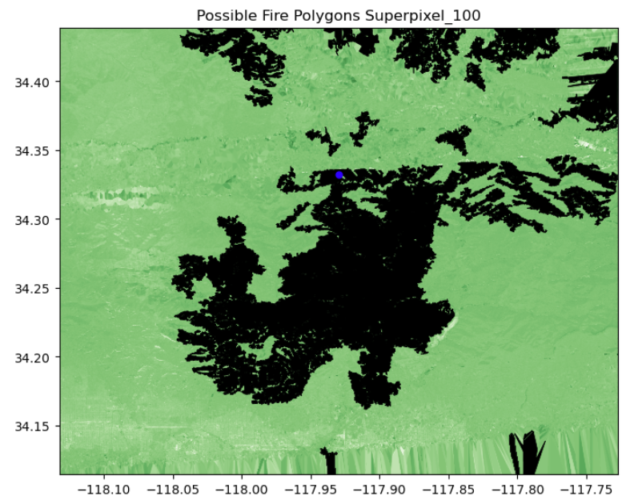
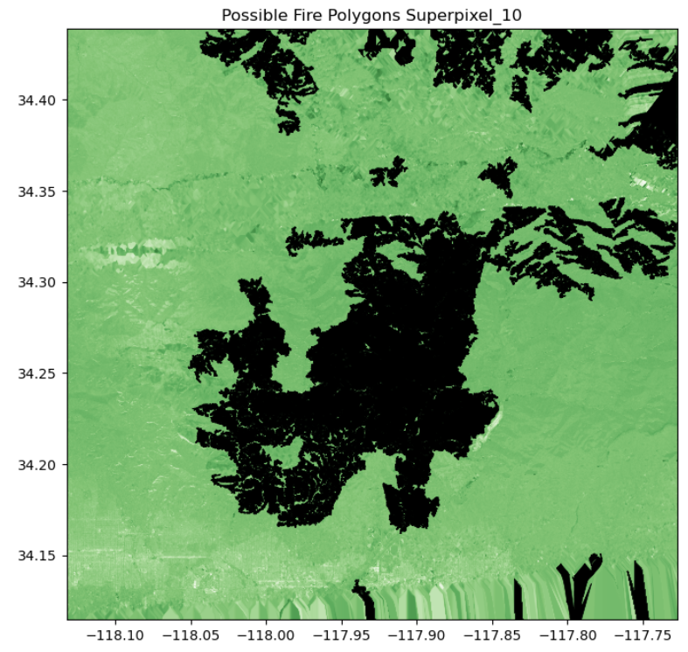

Perimeter generation K-means

Slide 21
Next Steps: Bobcat Project
We will check if burn severity output improves by using only alpha values and removing hv values.
We will try augmenting the dataset of Entropy and Anisotropy to the dataset.

Slide 22
Bobcat Wildfire Project
Update June 6, 2025

Slide 23
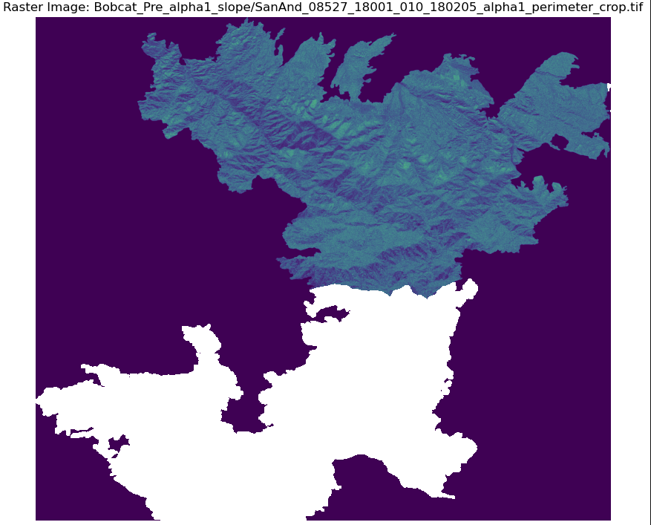
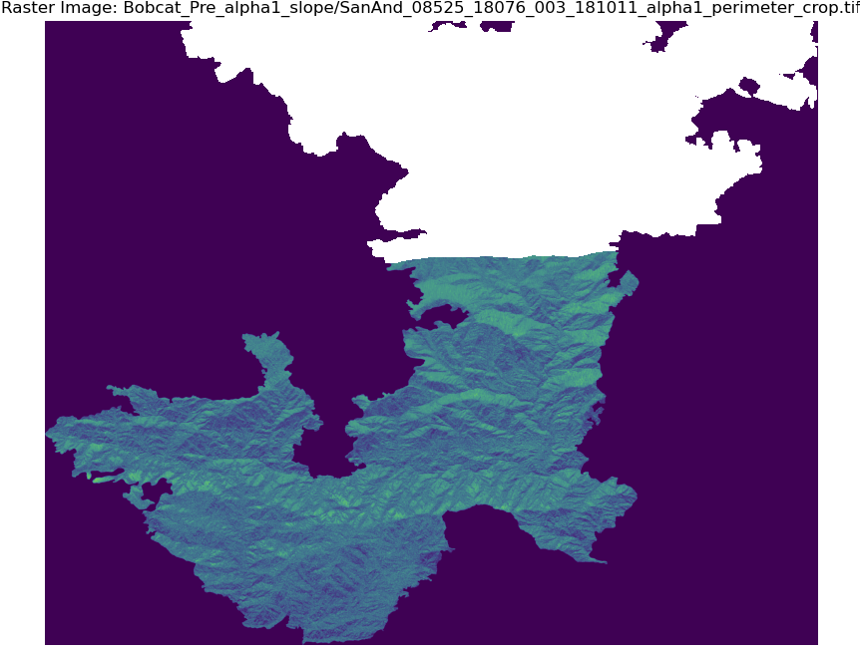
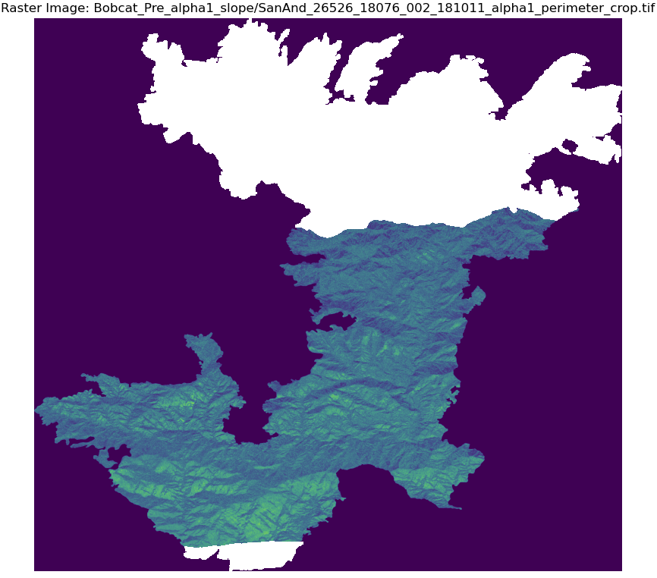
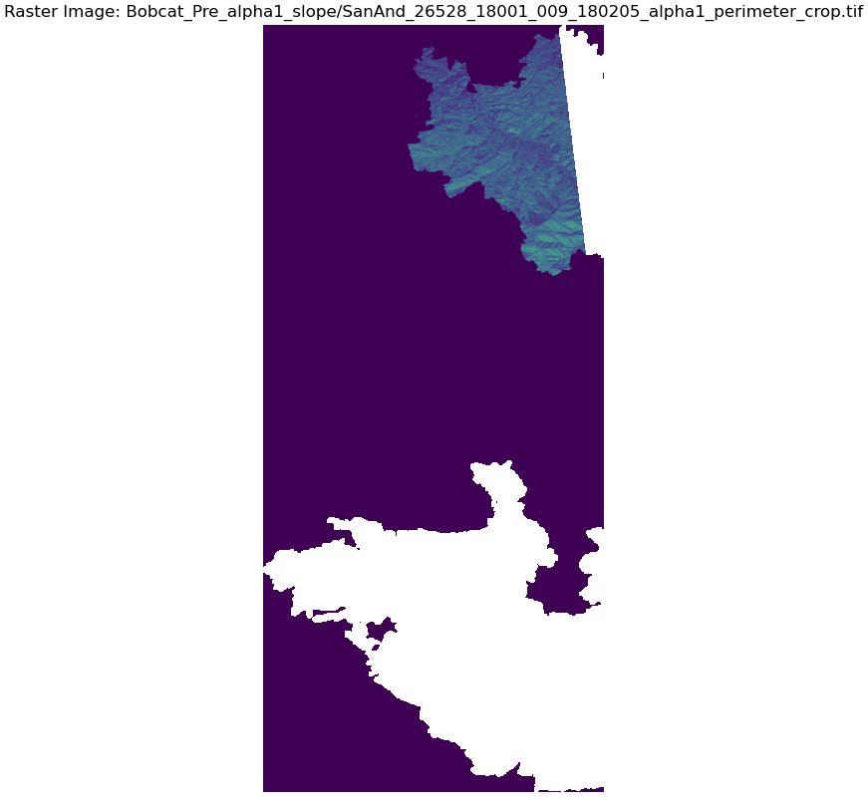
Pre Alpha

Slide 24
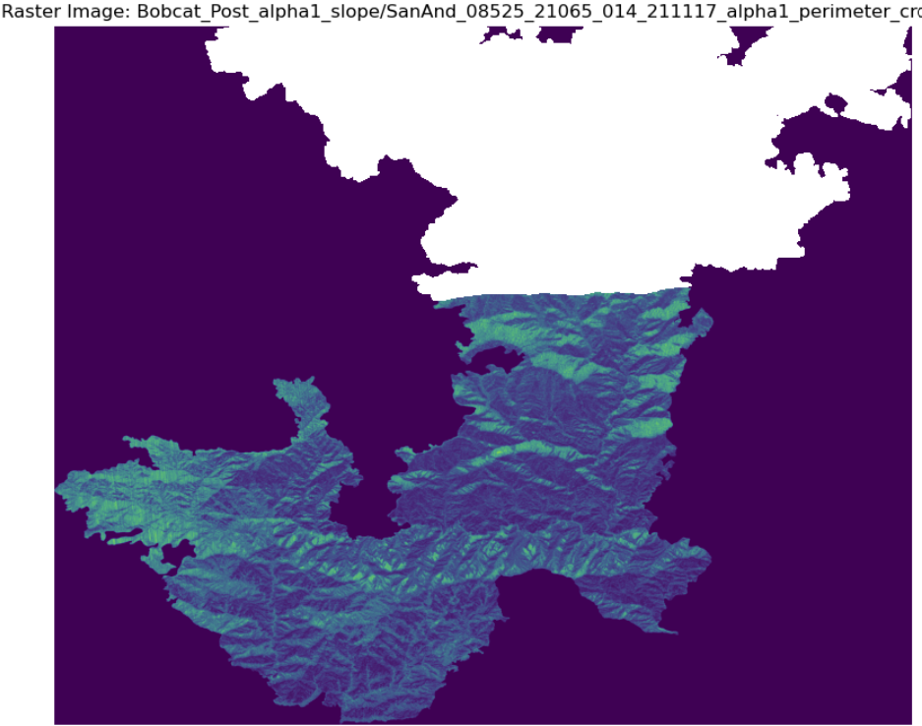
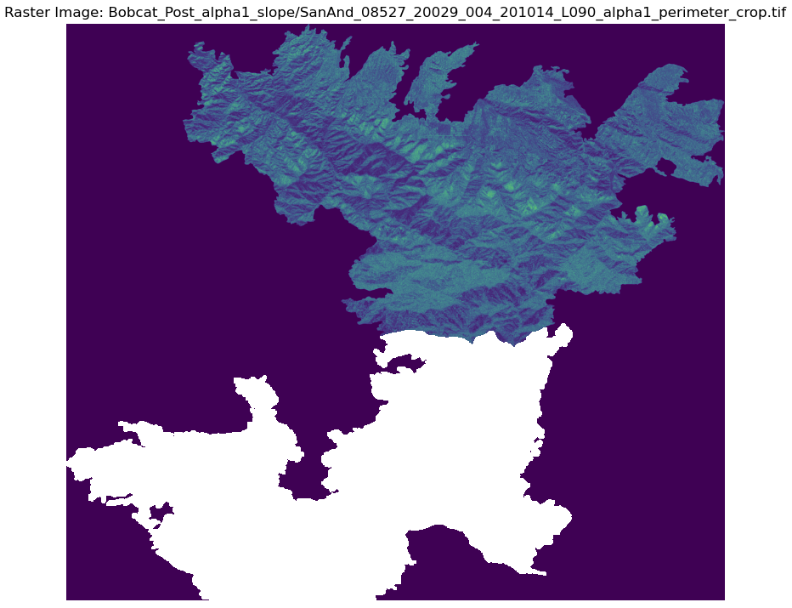
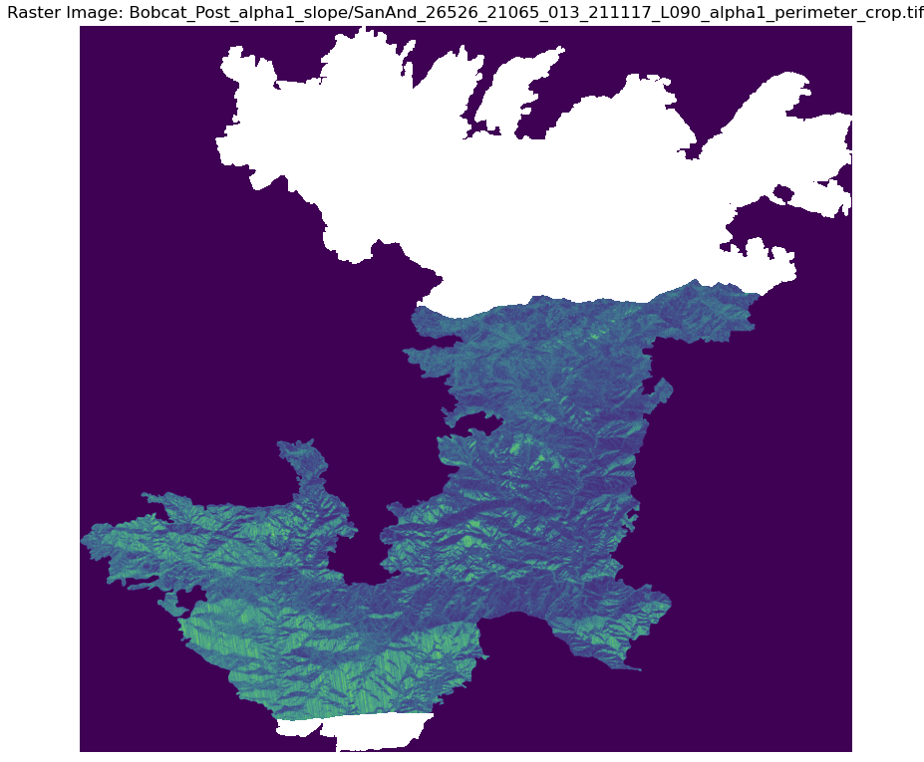
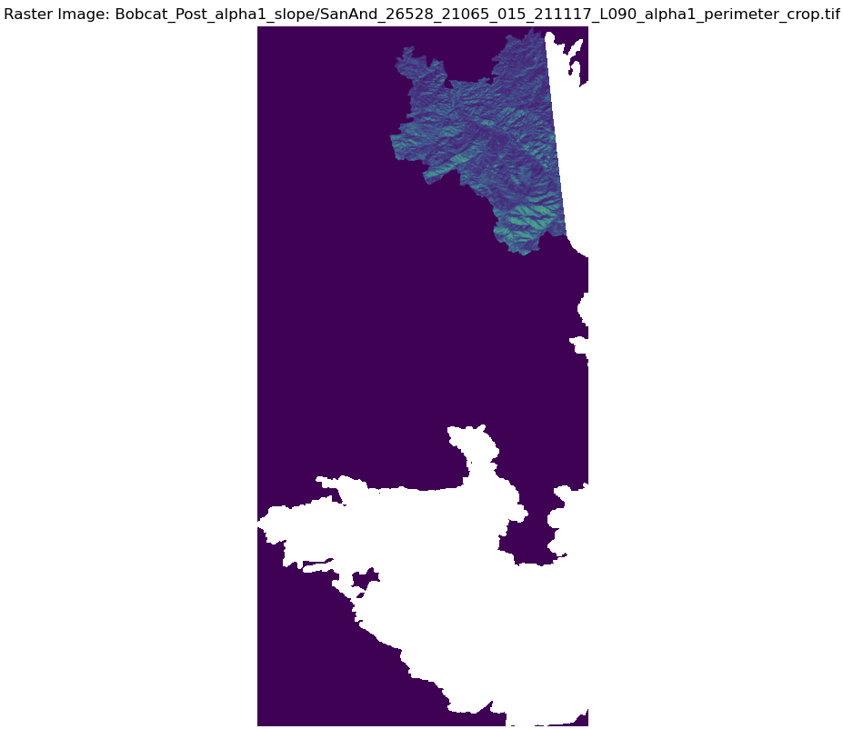
Post Alpha

Slide 25
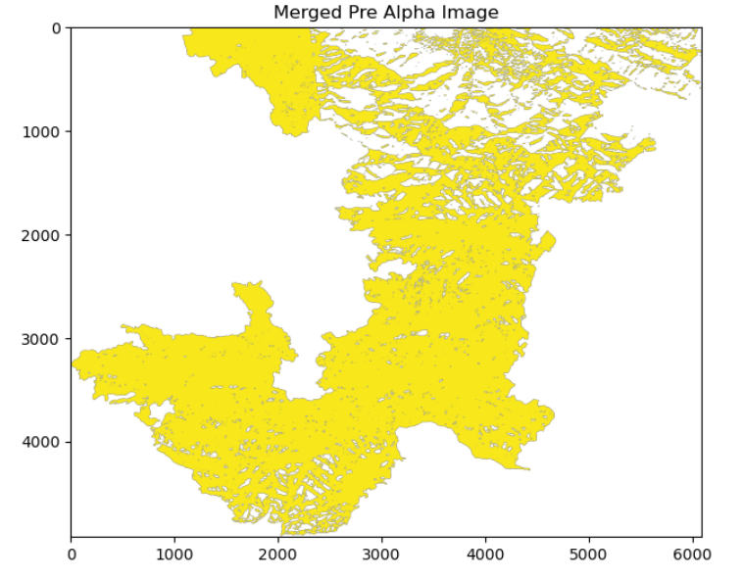
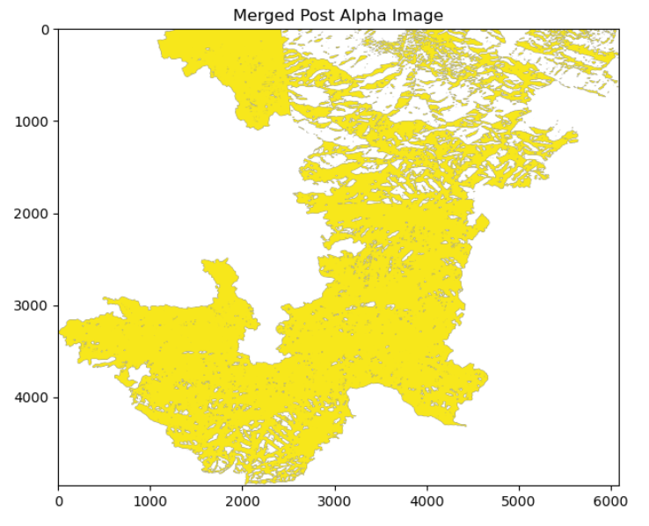
Merged Pre Alpha Image
Merged Post Alpha Image

Slide 26
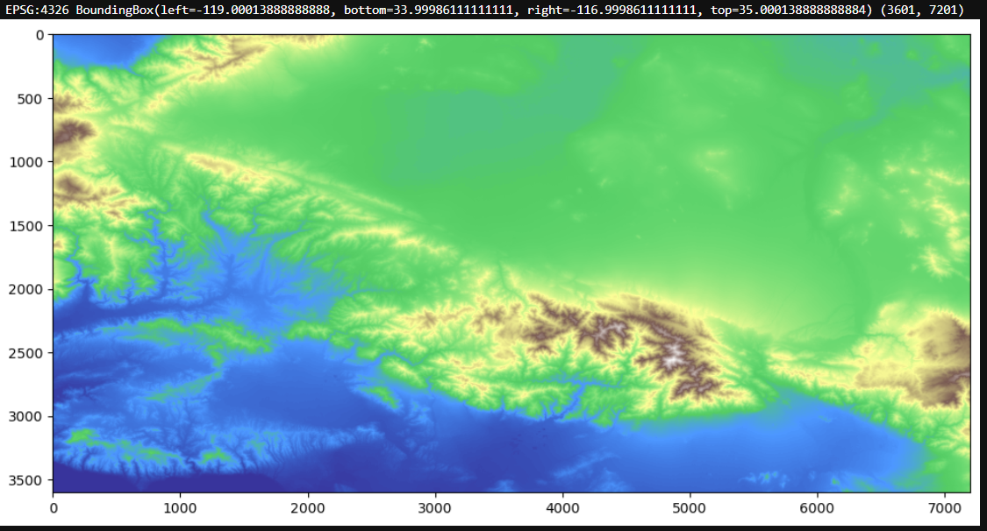
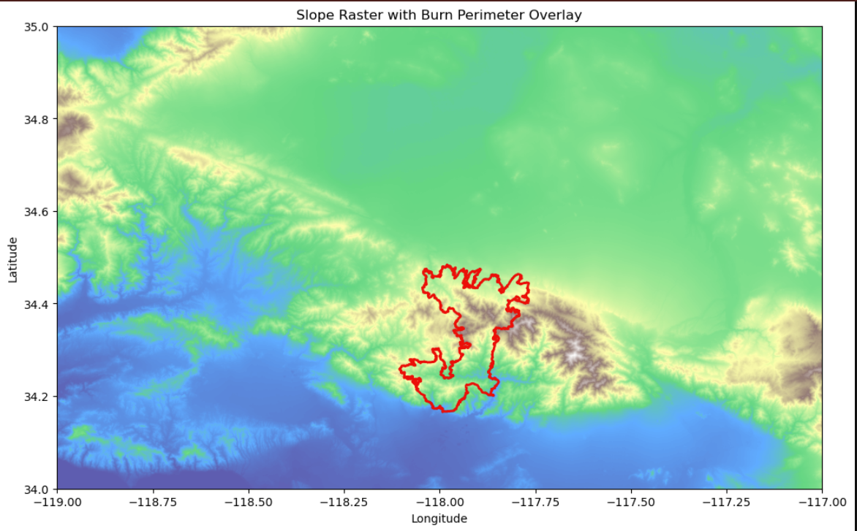
Slope

Slide 27
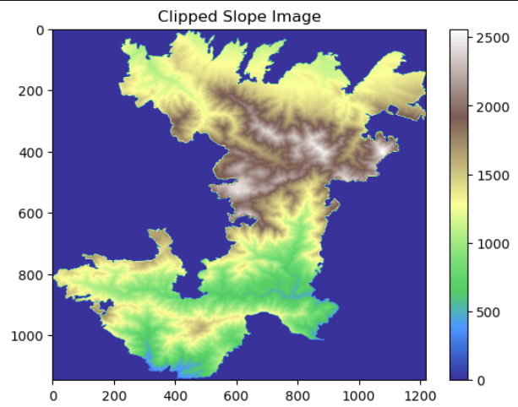
Slope

Slide 28
Next Steps: Bobcat Project
We are currently working on calculating the change in Alpha-1 values by subtracting the pre-fire Alpha-1 data from the post-fire Alpha-1 data.
We will combine the slope data with the Alpha-1 change map to improve the detection of burned areas. By identifying places where the Alpha-1 difference is high and the slope is steep, we will more accurately classify the areas affected by fire.

Slide 29
Bobcat Wildfire Project
Update June 20, 2025

Slide 30
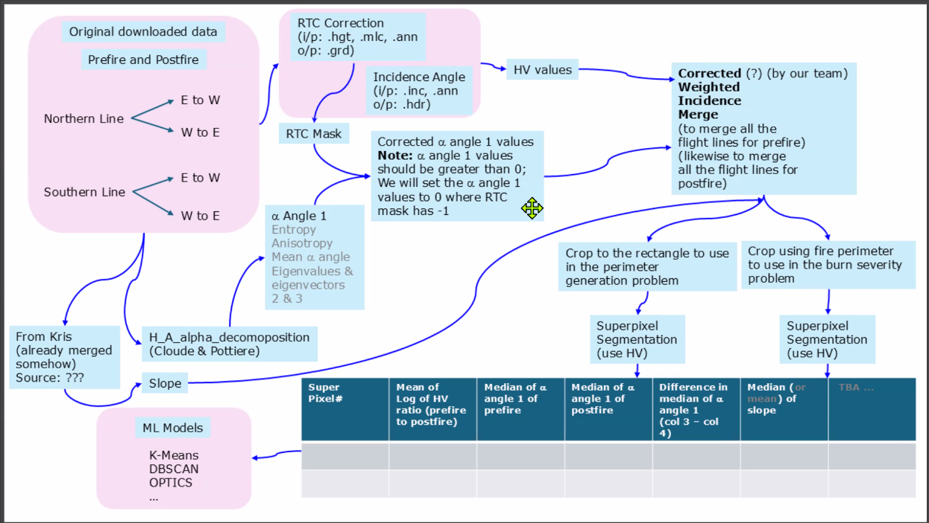
Current Workflow

Slide 31
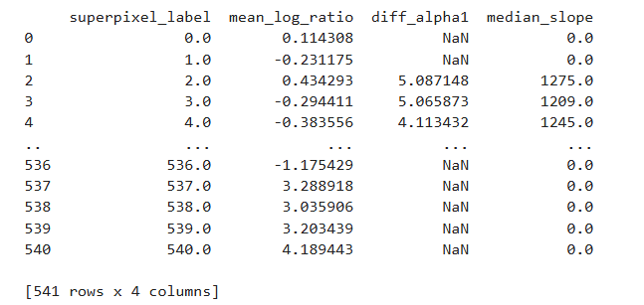
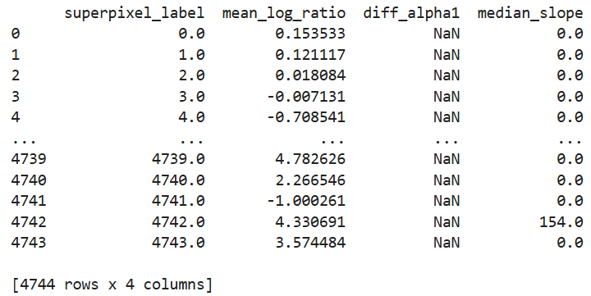
Statistical Metrics per Superpixel (DataFrame Summary)
Data Frame for Superpixel minsize 10,000
Data Frame for Superpixel minsize 100

Slide 32
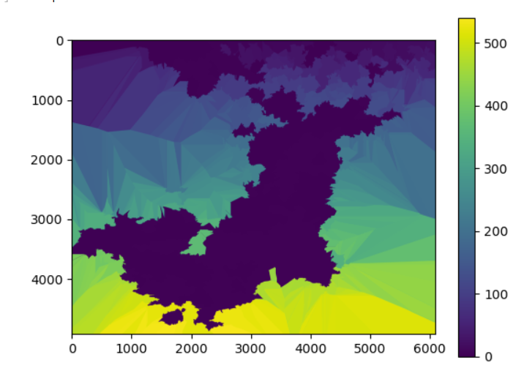
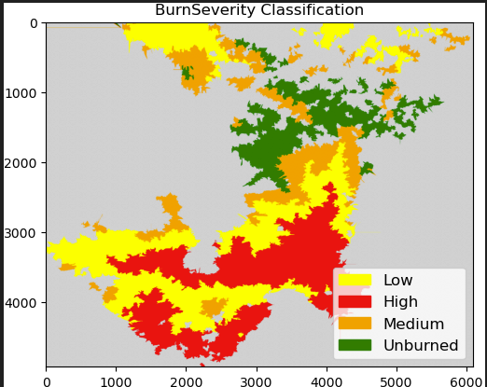
Burn Severity Classification Superpixel minsize 10000
Ground Truth

Slide 33
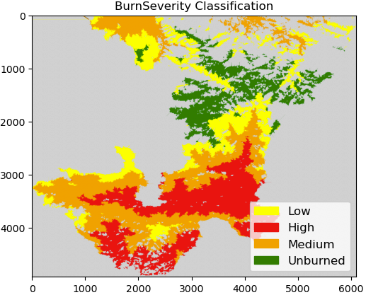
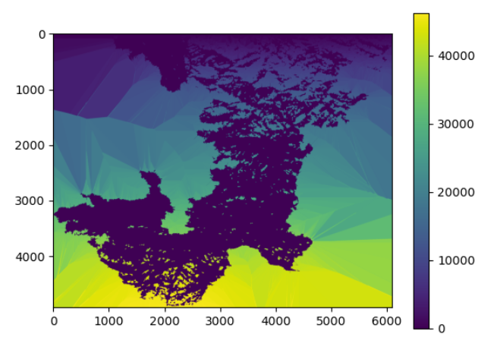
Burn Severity Classification Superpixel minsize 100
Ground Truth

Slide 34
Next Steps: Bobcat Project
Replace "Difference in median of alpha angle 1" with separate "Prefire" and "Postfire" median values to see if clustering improves.
Fine-tune K-means hyperparameters for better performance.
Test alternative clustering methods like DBSCAN and OPTICS for more flexible cluster detection.

